Slide 1
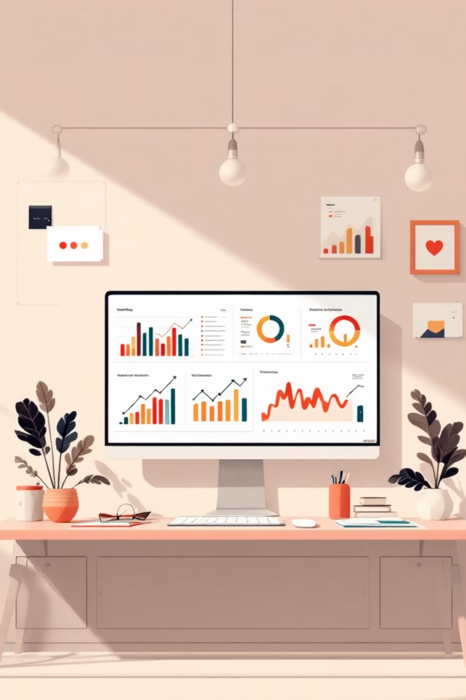
Customer Shopping Behavior Analysis
Uncovering insights from 3,900 purchases to drive strategic decisions

Slide 2

OVERVIEW
Project Scope
Our Mission
Analyze transactional data to uncover spending patterns, customer segments, and product preferences
3.9K
18
4
Purchases
Data Points
Categories

Slide 3


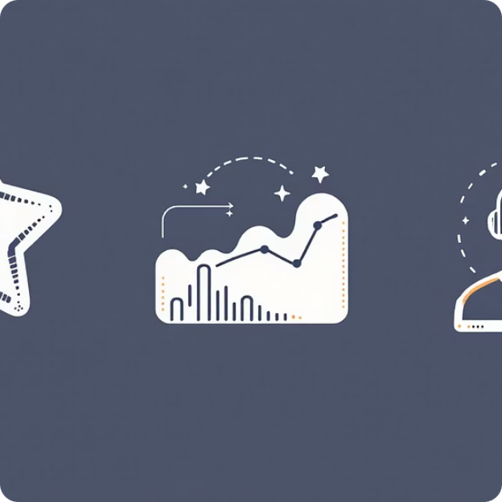

DATA FOUNDATION
Dataset at a Glance
Demographics
Purchase Details
Shopping Behavior
Age, gender, location, subscription status
Item, category, amount, season, size, color
Discounts, reviews, frequency, shipping type
Missing data: 37 values in Review Rating column (handled via median imputation)

Slide 4

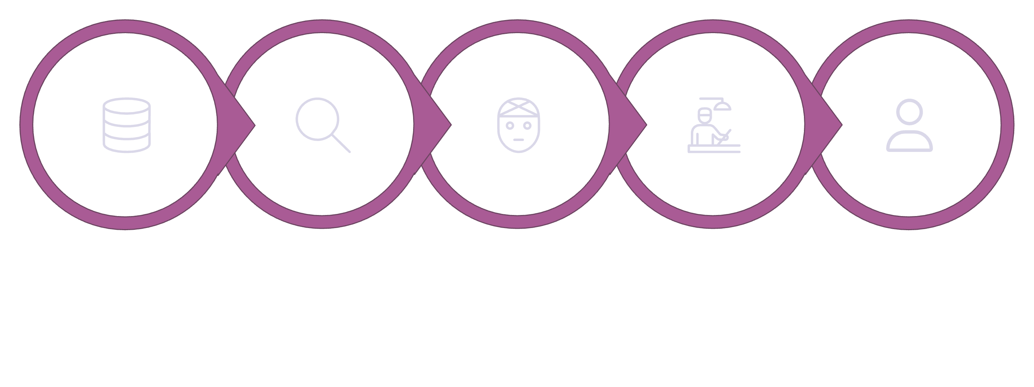
PYTHON
Data Preparation & Cleaning
Load Data
Explore & Clean
Handle Missing
Engineer Features
Export to PostgreSQL
Transformed raw data into analysis-ready format through systematic cleaning and feature engineering
Standardization
Feature Engineering
Data Validation
Renamed columns to snake_case for consistency
Created age_group and purchase_frequency_days
Removed redundant promo_code_used column

Slide 5
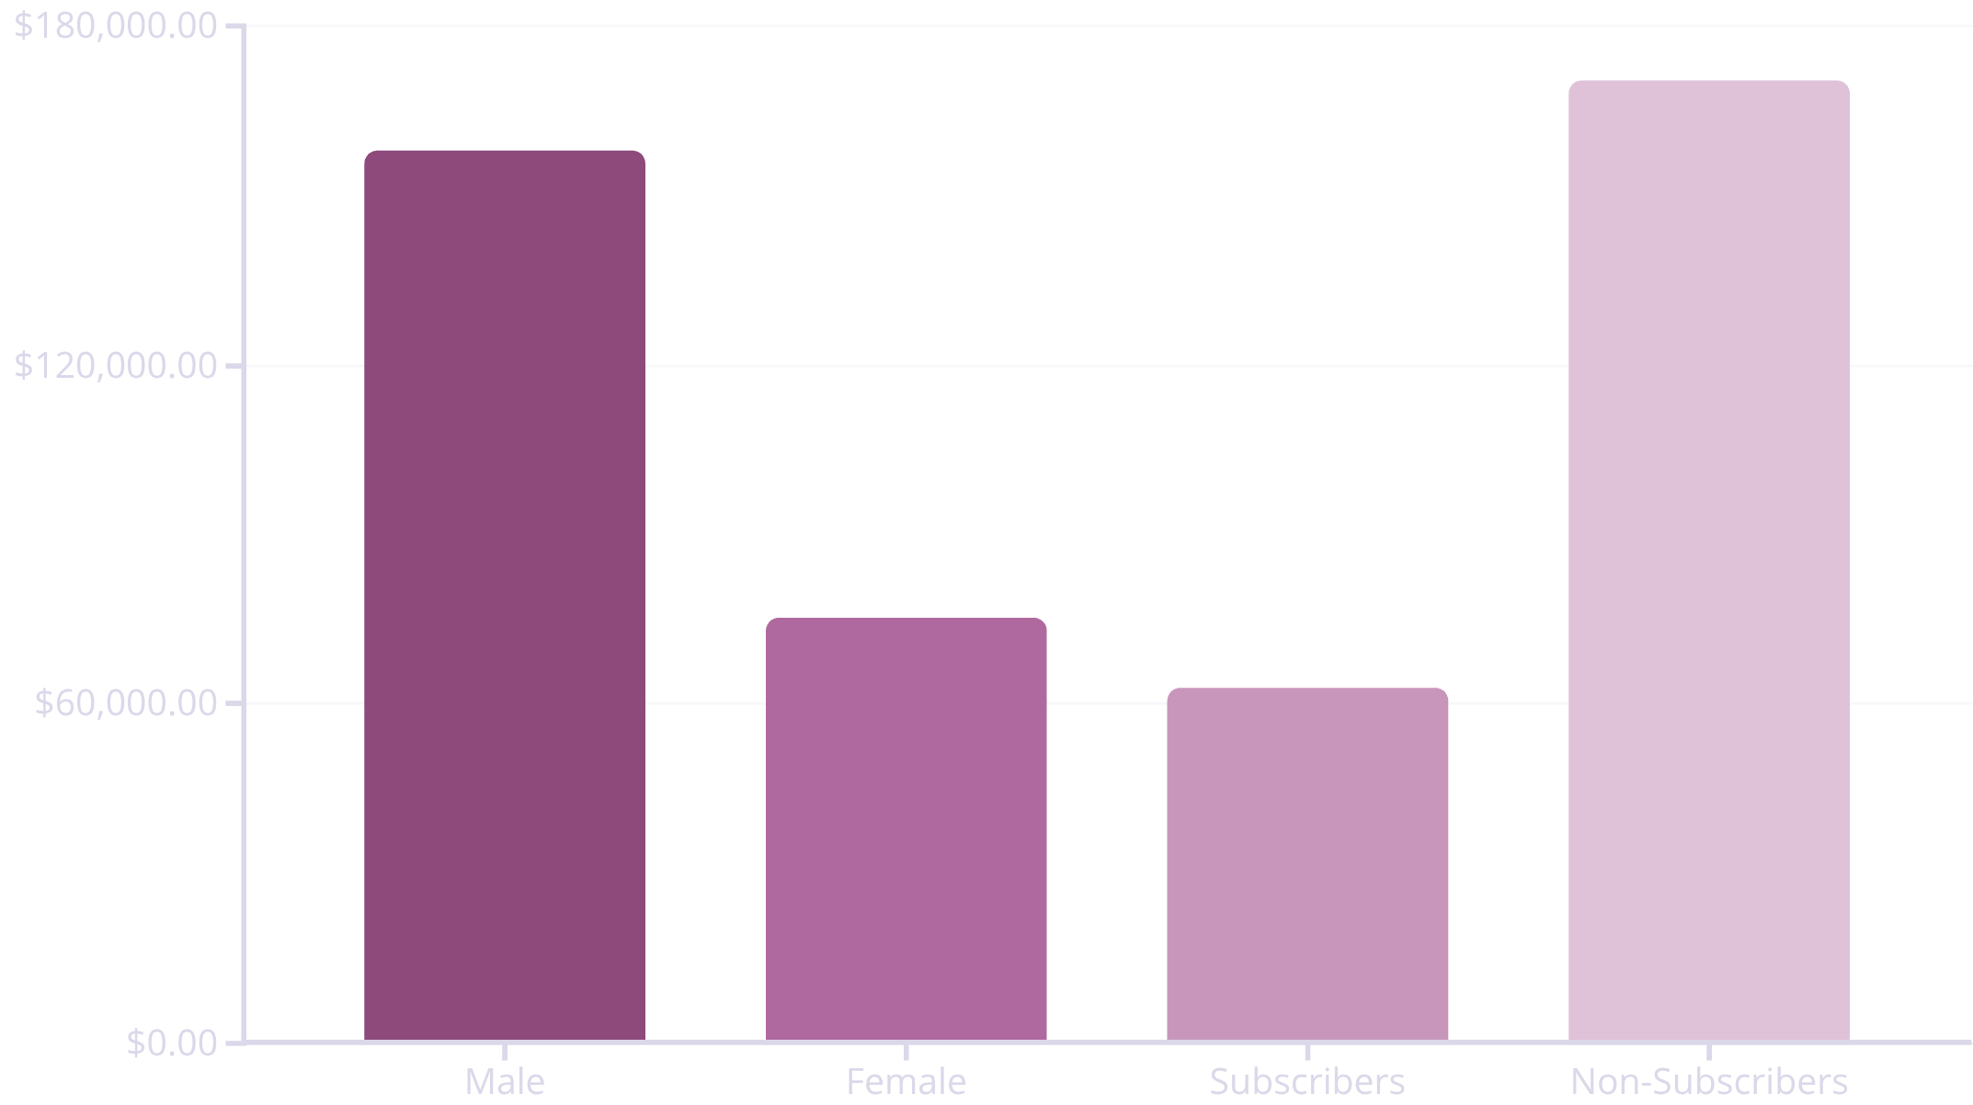
SQL ANALYSIS
Revenue Insights
Key Findings
Male customers generate 2.1x more revenue than female customers
Non-subscribers contribute 73% of total revenue despite lower average spend
Express shipping users spend $2 more on average than standard shipping

Slide 6
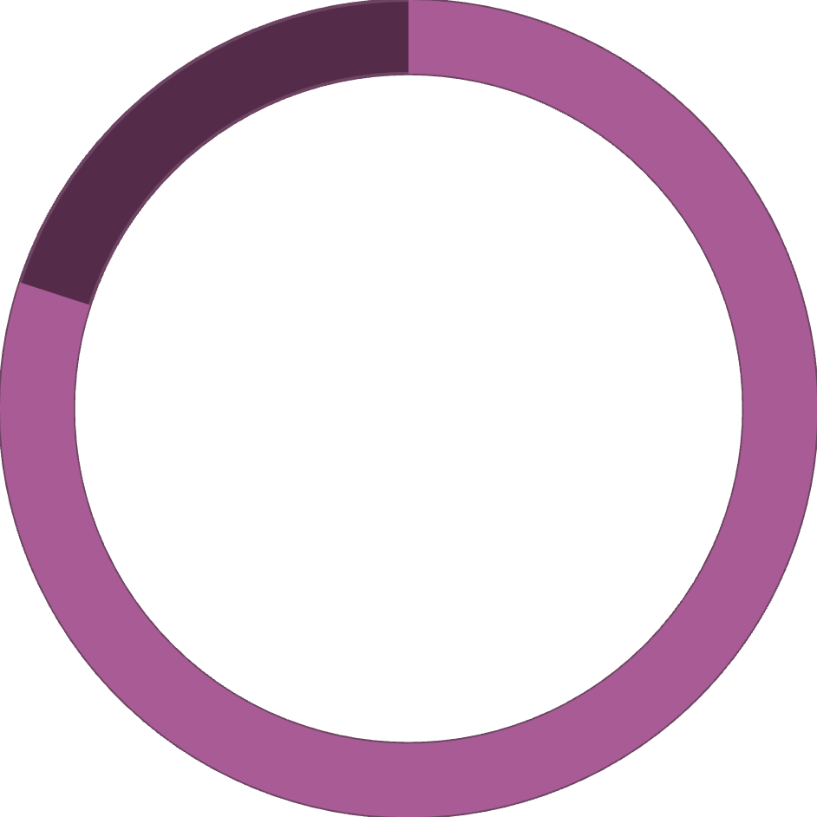
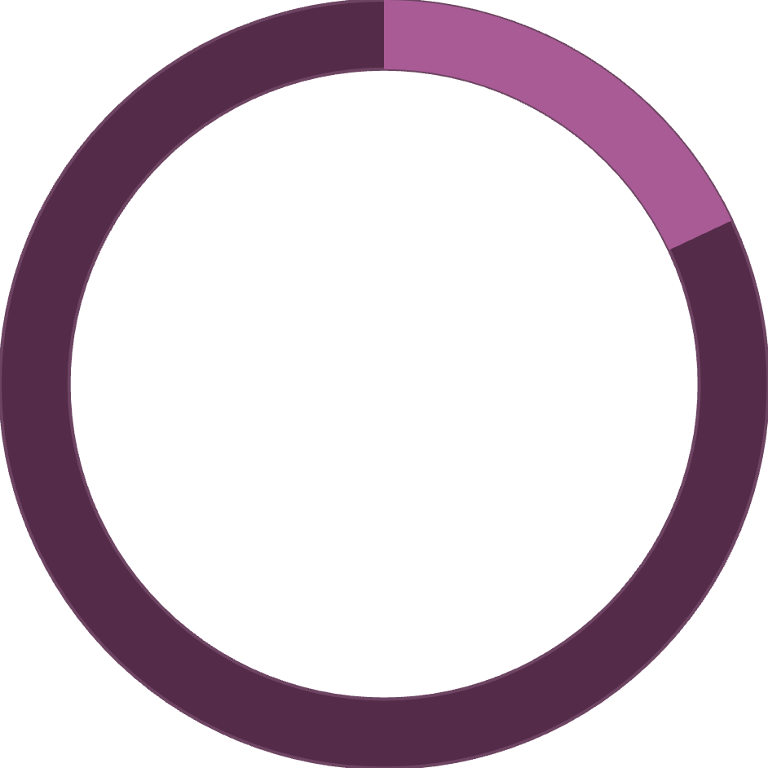

Customer Segmentation
Distribution by Loyalty
Classification based on purchase history reveals customer engagement patterns
80%
18%
2%
Loyal
Returning
New
3,116 customers
701 customers
83 customers

Slide 7



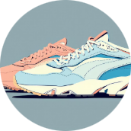
PRODUCT PERFORMANCE
Top-Rated & Discount-Dependent Items
Gloves
Sandals
Hat
Sneakers
Highest rating: 3.86 stars
Second highest: 3.84 stars
50% discount rate - highest dependency
49.66% discount rate
839 customers used discounts but still spent above average purchase amount

Slide 8

Power BI Dashboard
Interactive visualization bringing data insights to life
Subscription Status
Top Category
Average Metrics
27% Yes, 73% No
Clothing: $100K revenue
$59.76 spend, 3.75 rating

Slide 9



RECOMMENDATIONS
Strategic Action Plan
Boost Subscriptions
Loyalty Programs
Optimize Discounts
Promote exclusive benefits to convert the 73% non-subscriber base
Reward repeat buyers to grow the 80% loyal segment
Balance sales boosts with margin control on high-discount items

Slide 10

Next Steps
Transform insights into action with data-driven decision making
Implementation Priorities
01
02
Targeted Marketing
Product Positioning
Focus on high-revenue age groups and express shipping users
Highlight top-rated items in campaigns
03
Monitor & Iterate
Track KPIs and adjust strategy quarterly

